Slide 1
Unit Test

Slide 2
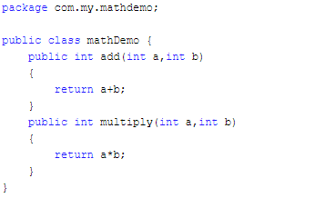
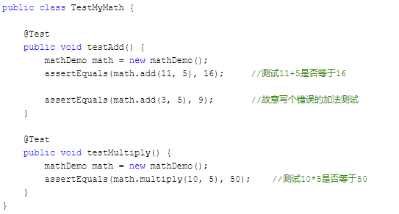
A Sample

Slide 3
Summary
void assertEquals(boolean expected, boolean actual)
Check that two primitives/Objects are equal
void assertTrue(boolean expected)
Check that a condition is true
void assertFalse(boolean condition)
Check that a condition is false
void assertNotNull(Object object)
Check that an object isn't null
void assertNull(Object object)
Check that an object is null
void assertSame(Object object, Object object)
The assertSame() methods tests if two object references point to the same object
void assertNotSame(Object object, Object object)
The assertNotSame() methods tests if two object references not point to the same object
void assertArrayEquals(expectedArray, resultArray);
The assertArrayEquals() method will test whether two arrays are equal to each other.

Slide 4
assertTrue() and assertFalse()
The assertTrue() and assertFalse() methods tests a single variable to see if its value is either true, or false.
If the program under test returns true, the assertTrue() method will return normally. Otherwise an exception will be thrown, and the test will stop.
If the program under test returns false, the assertFalse() method will return normally. Otherwise an exception will be thrown, and the test will stop.

Slide 5
assertNull() and assertNotNull()
The assertNull() and assertNotNull() methods test a single variable to see if it is null or not null.
If the program returns null, the assertNull() method will return normally. If a non-null value is returned, the assertNull() method will throw an exception, and the test will stop.
The assertNotNull() method works in the opposite way to the assertNull() method,

Slide 6
assertEquals()
The assertEquals() method compares two objects for equality
If the two objects are equal, the assertEquals() method will return normally. Otherwise the assertEquals() method will throw an exception.
The assertEquals() method can compare any two objects to each other, it has versions that compare primitive types like int and float to each other.

Slide 7
assertArrayEquals()
The assertArrayEquals() method will test whether two arrays are equal to each other. In other words, if the two arrays contain the same number of elements, and if all the elements in the array are equal to each other.
If the arrays are equal, the assertArrayEquals() will proceed without errors. If the arrays are not equal, an exception will be thrown, and the test aborted.

Slide 8
assertSame() and assertNotSame()
The assertSame() and assertNotSame() methods tests if two object references point to the same object or not. It is not enough that the two objects pointed to are equals according to their equals() methods. It must be exactly the same object pointed to.

Slide 9
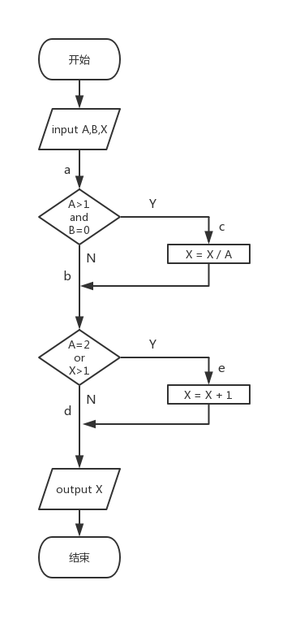
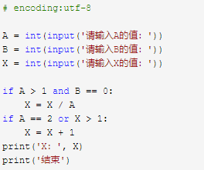
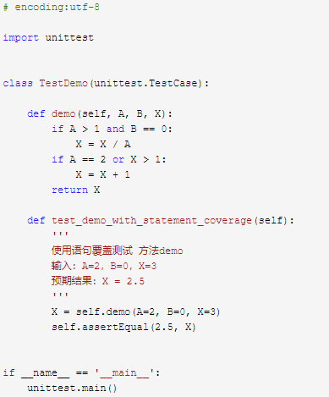
A Sample
Notes:
1A=2，B=0，X=3a-c-eX=2.5

Slide 10
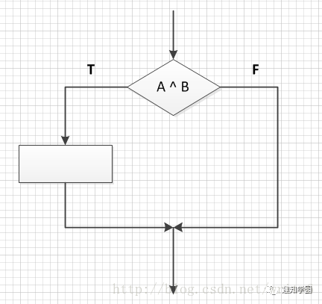
Statement coverage
Notes:
（1）语句覆盖
使程序中的每个可执行语句都能执行一次的测试用例
测试用例条件： A ^ B = T

Slide 11
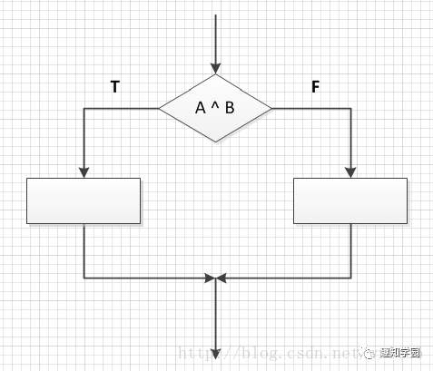
Determine coverage
Branch coverage
Notes:
对于判断语句，在设计用例的时候，要设计判断语句结果为True和False的两种情况
测试用例条件：
A ^ B = T
A ^ B = F

Slide 12
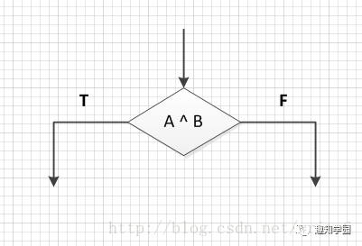
Condition coverage
Notes:
（3）条件覆盖
设计用例时针对判断语句里面每个条件表达式true 和 false各取值一次，不考判断语句的计算结果
测试用例条件：
A=T A=F
B=T B=F

Slide 13
Branch conditional coverage
Notes:
（4）判定条件覆盖（分支条件覆盖）
设计测试用例时，使得判断语句中每个条件表达式的所有可能结果至少出现一次，每个判断语句本身所有可能结果也至少出现一次。
测试用例条件：
A ^ B = T A ^ B = F
A=T A=F
B=T B=F

Slide 14
Conditional combination coverage
Notes:
（5）条件组合覆盖
设计测试用例时，使得每个判断语句中条件结果的所有可能组合至少出现一次
测试用例条件：
A= T B= T
A= T B= F
A= F B= T
A= F B= F

Slide 15
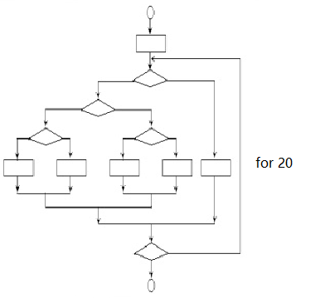
Path coverage
Notes:
上图中包含的不同执行路径数达5的20次方条路径，假定对每一条路径进行测试需要1毫秒，一年工作365 × 24小时，要想把所有路径测试完，需3170年。

Slide 16
For 循环
for fruit in fruits:
  print(“当前水果： ”, fruit)
for i in range(2, 10):
  print(“当前数字：”, i)
for i in range(2, 10):
  print(“当前数字：”, i)
else：
  print(“这个数字 ”, i, “我搞不定”)

Slide 17
While循环
While a<10:
  print(a)
while a<10:
  print(a)
  if a>8:
    break

Slide 18
Control Flow Graph (CFG)
短路
循环体
循环跳出

